Slide 1
Depth-First Search
CSE-207

Slide 2
Last Class’s Topic
Graph Representation
  Adjacency Matrix
  Adjacency List

Slide 3
Depth-First Search
Input:
  G = (V, E) (No source vertex given!)
Goal:
  Explore the edges of G to “discover” every vertex in V starting at the most current visited node
  Search may be repeated from multiple sources
Output:
  2 timestamps on each vertex:
    d[v] = discovery time
    f[v] = finishing time (done with examining v’s adjacency list)
  Depth-first forest
1
2
3
5
4

Slide 4
Depth-First Search
Search “deeper” in the graph whenever possible
Edges are explored out of the most recently discovered vertex v that still has unexplored edges
2
1
3
5
4
After all edges of v have been explored, the search “backtracks” from the parent of v
The process continues until all vertices reachable from the original source have been discovered
If undiscovered vertices remain, choose one of them as a new source and repeat the search from that vertex
DFS creates a “depth-first forest”

Slide 5
DFS Additional Data Structures
Global variable: time-stamp
  Incremented when nodes are discovered or finished
color[u] – similar to BFS
  White before discovery, gray while processing and black when finished processing
prev[u] – predecessor of u
d[u], f[u] – discovery and finish times
1 ≤ d[u] < f [u] ≤ 2 |V|
WHITE
GRAY
BLACK
0
d[u]
f[u]
2V

Slide 6
Depth-First Search: The Code
Data: color[V], time, prev[V],d[V], f[V]
DFS(G) // where prog starts
{
for each vertex u ∈ V
{
color[u] = WHITE;
prev[u]=NIL;
f[u]=inf; d[u]=inf;
}
time = 0;
for each vertex u ∈ V
if (color[u] == WHITE)
DFS_Visit(u);
}
DFS_Visit(u)
{
color[u] = GREY;
time = time+1;
d[u] = time;
for each v ∈ Adj[u]
{
if(color[v] == WHITE){
prev[v]=u;
DFS_Visit(v);}
}
color[u] = BLACK;
time = time+1;
f[u] = time;
}
Initialize

Slide 7
Depth-First Search: The Code
Data: color[V], time, prev[V],d[V], f[V]
DFS(G) // where prog starts
{
for each vertex u ∈ V
{
color[u] = WHITE;
prev[u]=NIL;
f[u]=inf; d[u]=inf;
}
time = 0;
for each vertex u ∈ V
if (color[u] == WHITE)
DFS_Visit(u);
}
DFS_Visit(u)
{
color[u] = GREY;
time = time+1;
d[u] = time;
for each v ∈ Adj[u]
{
if(color[v] == WHITE){
prev[v]=u;
DFS_Visit(v);}
}
color[u] = BLACK;
time = time+1;
f[u] = time;
}
What does u[d] represent?

Slide 8
Depth-First Search: The Code
Data: color[V], time, prev[V],d[V], f[V]
DFS(G) // where prog starts
{
for each vertex u ∈ V
{
color[u] = WHITE;
prev[u]=NIL;
f[u]=inf; d[u]=inf;
}
time = 0;
for each vertex u ∈ V
if (color[u] == WHITE)
DFS_Visit(u);
}
DFS_Visit(u)
{
color[u] = GREY;
time = time+1;
d[u] = time;
for each v ∈ Adj[u]
{
if(color[v] == WHITE){
prev[v]=u;
DFS_Visit(v);}
}
color[u] = BLACK;
time = time+1;
f[u] = time;
}
What does f[d] represent?

Slide 9
Depth-First Search: The Code
Data: color[V], time, prev[V],d[V], f[V]
DFS(G) // where prog starts
{
for each vertex u ∈ V
{
color[u] = WHITE;
prev[u]=NIL;
f[u]=inf; d[u]=inf;
}
time = 0;
for each vertex u ∈ V
if (color[u] == WHITE)
DFS_Visit(u);
}
DFS_Visit(u)
{
color[u] = GREY;
time = time+1;
d[u] = time;
for each v ∈ Adj[u]
{
if(color[v] == WHITE){
prev[v]=u;
DFS_Visit(v);
}}
color[u] = BLACK;
time = time+1;
f[u] = time;
}
Will all vertices eventually be colored black?

Slide 10
DFS Example
source
vertex
S
D
F
A
E
B
C
G

Slide 11
DFS Example
source
vertex
d f
F
S
D
1 |
|
|
A
|
|
E
|
|
|
B
C
G

Slide 12
DFS Example
source
vertex
d f
F
S
D
1 |
|
|
A
2 |
|
E
|
|
|
B
C
G

Slide 13
DFS Example
source
vertex
d f
F
S
D
1 |
|
|
A
2 |
|
E
3 |
|
|
B
C
G

Slide 14
DFS Example
source
vertex
d f
F
S
D
1 |
|
|
A
2 |
|
E
3 | 4
|
|
B
C
G

Slide 15
DFS Example
source
vertex
d f
F
S
D
1 |
|
|
A
2 |
|
E
3 | 4
5 |
|
B
C
G

Slide 16
DFS Example
source
vertex
d f
F
S
D
1 |
|
|
A
2 |
|
E
3 | 4
5 | 6
|
B
C
G

Slide 17
DFS Example
source
vertex
d f
F
S
D
1 |
|
|
A
2 | 7
|
E
3 | 4
5 | 6
|
B
C
G

Slide 18
DFS Example
source
vertex
d f
F
S
D
1 |
8 |
|
A
2 | 7
|
E
3 | 4
5 | 6
|
B
C
G

Slide 19
DFS Example
source
vertex
d f
F
S
D
1 |
8 |
|
A
2 | 7
9 |
E
3 | 4
5 | 6
|
B
C
G
What is the structure of the grey vertices?
What do they represent?

Slide 20
DFS Example
source
vertex
d f
F
S
D
1 |
8 |
|
A
2 | 7
9 |10
E
3 | 4
5 | 6
|
B
C
G

Slide 21
DFS Example
source
vertex
d f
F
S
D
1 |
8 |11
|
A
2 | 7
9 |10
E
3 | 4
5 | 6
|
B
C
G

Slide 22
DFS Example
source
vertex
d f
F
S
D
1 |12
8 |11
|
A
2 | 7
9 |10
E
3 | 4
5 | 6
|
B
C
G

Slide 23
DFS Example
source
vertex
d f
F
S
D
1 |12
8 |11
13|
A
2 | 7
9 |10
E
3 | 4
5 | 6
|
B
C
G

Slide 24
DFS Example
source
vertex
d f
F
S
D
1 |12
8 |11
13|
A
2 | 7
9 |10
E
3 | 4
5 | 6
14|
B
C
G

Slide 25
DFS Example
source
vertex
d f
F
S
D
1 |12
8 |11
13|
A
2 | 7
9 |10
E
3 | 4
5 | 6
14|15
B
C
G

Slide 26
DFS Example
source
vertex
d f
F
S
D
1 |12
8 |11
13|16
A
2 | 7
9 |10
E
3 | 4
5 | 6
14|15
B
C
G

Slide 27
Depth-First Search: The Code
Data: color[V], time, prev[V],d[V], f[V]
DFS(G) // where prog starts
{
for each vertex u ∈ V
{
color[u] = WHITE;
prev[u]=NIL;
f[u]=inf; d[u]=inf;
}
time = 0;
for each vertex u ∈ V
if (color[u] == WHITE)
DFS_Visit(u);
}
DFS_Visit(u)
{
color[u] = GREY;
time = time+1;
d[u] = time;
for each v ∈ Adj[u]
{
if (color[v] == WHITE)
prev[v]=u;
DFS_Visit(v);
}
color[u] = BLACK;
time = time+1;
f[u] = time;
}
What will be the running time?

Slide 28
Depth-First Search: The Code
Data: color[V], time, prev[V],d[V], f[V]
DFS(G) // where prog starts
{
for each vertex u ∈ V
{
color[u] = WHITE;
prev[u]=NIL;
f[u]=inf; d[u]=inf;
}
time = 0;
for each vertex u ∈ V
if (color[u] == WHITE)
DFS_Visit(u);
}
DFS_Visit(u)
{
color[u] = GREY;
time = time+1;
d[u] = time;
for each v ∈ Adj[u]
{
if (color[v] == WHITE)
prev[v]=u;
DFS_Visit(v);
}
color[u] = BLACK;
time = time+1;
f[u] = time;
}
O(V)
O(V)
O(V)
Running time: O(V²) because call DFS_Visit on each vertex,
and the loop over Adj[] can run as many as |V| times

Slide 29
Depth-First Search: The Code
Data: color[V], time, prev[V],d[V], f[V]
DFS(G) // where prog starts
{
for each vertex u ∈ V
{
color[u] = WHITE;
prev[u]=NIL;
f[u]=inf; d[u]=inf;
}
time = 0;
for each vertex u ∈ V
if (color[u] == WHITE)
DFS_Visit(u);
}
DFS_Visit(u)
{
color[u] = GREY;
time = time+1;
d[u] = time;
for each v ∈ Adj[u]
{
if (color[v] == WHITE)
prev[v]=u;
DFS_Visit(v);
}
color[u] = BLACK;
time = time+1;
f[u] = time;
}
BUT, there is actually a tighter bound.
How many times will DFS_Visit() actually be called?

Slide 30
Depth-First Search: The Code
Data: color[V], time, prev[V],d[V], f[V]
DFS(G) // where prog starts
{
for each vertex u ∈ V
{
color[u] = WHITE;
prev[u]=NIL;
f[u]=inf; d[u]=inf;
}
time = 0;
for each vertex u ∈ V
if (color[u] == WHITE)
DFS_Visit(u);
}
DFS_Visit(u)
{
color[u] = GREY;
time = time+1;
d[u] = time;
for each v ∈ Adj[u]
{
if (color[v] == WHITE)
prev[v]=u;
DFS_Visit(v);
}
color[u] = BLACK;
time = time+1;
f[u] = time;
}
So, running time of DFS = O(V+E)

Slide 31
Depth-First Sort Analysis
This running time argument is an informal example of amortized analysis
  “Charge” the exploration of edge to the edge:
    Each loop in DFS_Visit can be attributed to an edge in the graph
    Runs once per edge if directed graph, twice if undirected
    Thus loop will run in O(E) time, algorithm O(V+E)
      Considered linear for graph, b/c adj list requires O(V+E) storage
  Important to be comfortable with this kind of reasoning and analysis

Slide 32
DFS: Kinds of edges
DFS introduces an important distinction among edges in the original graph:
  Tree edge: encounter new (white) vertex
    The tree edges form a spanning forest
    Can tree edges form cycles? Why or why not?
      No

Slide 33
DFS Example
source
vertex
d f
1 |12
8 |11
13|16
2 | 7
9 |10
3 | 4
5 | 6
14|15
Tree edges

Slide 34
DFS: Kinds of edges
DFS introduces an important distinction among edges in the original graph:
  Tree edge: encounter new (white) vertex
  Back edge: from descendent to ancestor
    Encounter a grey vertex (grey to grey)
    Self loops are considered as to be back edge.

Slide 35
DFS Example
source
vertex
d f
1 |12
8 |11
13|16
2 | 7
9 |10
3 | 4
5 | 6
14|15
Tree edges
Back edges

Slide 36
DFS: Kinds of edges
DFS introduces an important distinction among edges in the original graph:
  Tree edge: encounter new (white) vertex
  Back edge: from descendent to ancestor
  Forward edge: from ancestor to descendent
    Not a tree edge, though
    From grey node to black node

Slide 37
DFS Example
source
vertex
d f
1 |12
8 |11
13|16
2 | 7
9 |10
3 | 4
5 | 6
14|15
Tree edges
Back edges
Forward edges

Slide 38
DFS: Kinds of edges
DFS introduces an important distinction among edges in the original graph:
  Tree edge: encounter new (white) vertex
  Back edge: from descendent to ancestor
  Forward edge: from ancestor to descendent
  Cross edge: between a tree or subtrees
    From a grey node to a black node

Slide 39
DFS Example
source
vertex
d f
1 |12
8 |11
13|16
2 | 7
9 |10
3 | 4
5 | 6
14|15
Tree edges
Back edges
Forward edges
Cross edges

Slide 40
DFS: Kinds of edges
DFS introduces an important distinction among edges in the original graph:
  Tree edge: encounter new (white) vertex
  Back edge: from descendent to ancestor
  Forward edge: from ancestor to descendent
  Cross edge: between a tree or subtrees
Note: tree & back edges are important; most algorithms don’t distinguish forward & cross

Slide 41
More about the edges
Let (u,v) is an edge.
  If (color[v] = WHITE) then (u,v) is a tree edge
  If (color[v] = GRAY) then (u,v) is a back edge
  If (color[v] = BLACK) then (u,v) is a forward/cross edge
    Forward Edge: d[u]<d[v]
    Cross Edge: d[u]>d[v]

Slide 42
Depth-First Search - Timestamps
a
b
s
c
3/6
2/9
1/10
11/16
B
F
C
B
4/5
7/8
12/13
14/15
C
C
C
d
e
f
g

Slide 43
Depth-First Search - Timestamps
s
c
C
B
F
b
f
g
C
a
e
C
B
C
d

Slide 44
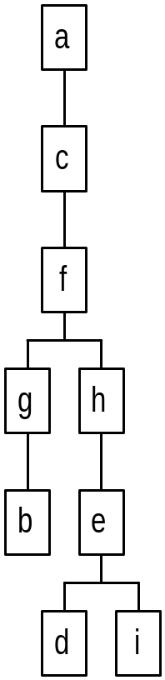
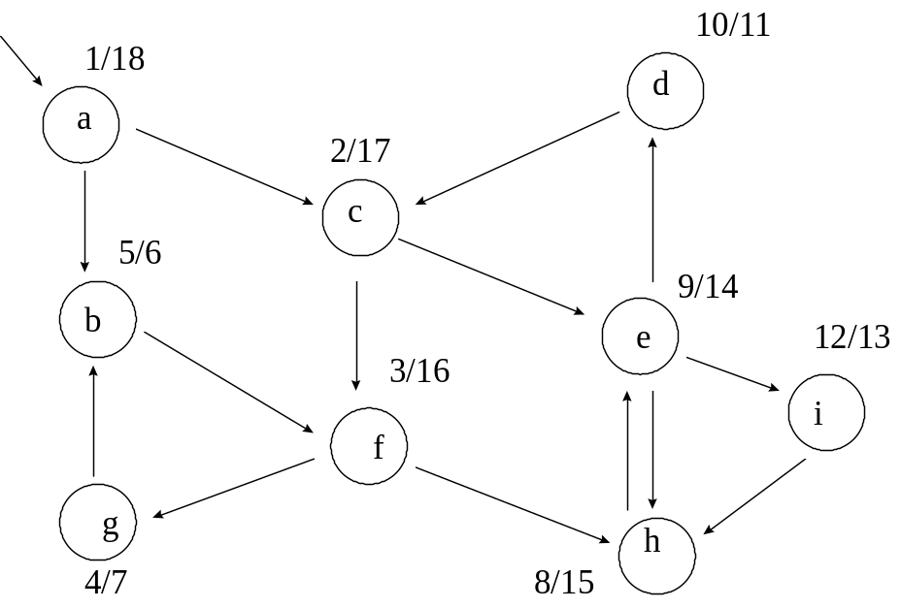
DFS Example
Result (start/finish time):
Tree:

Slide 45
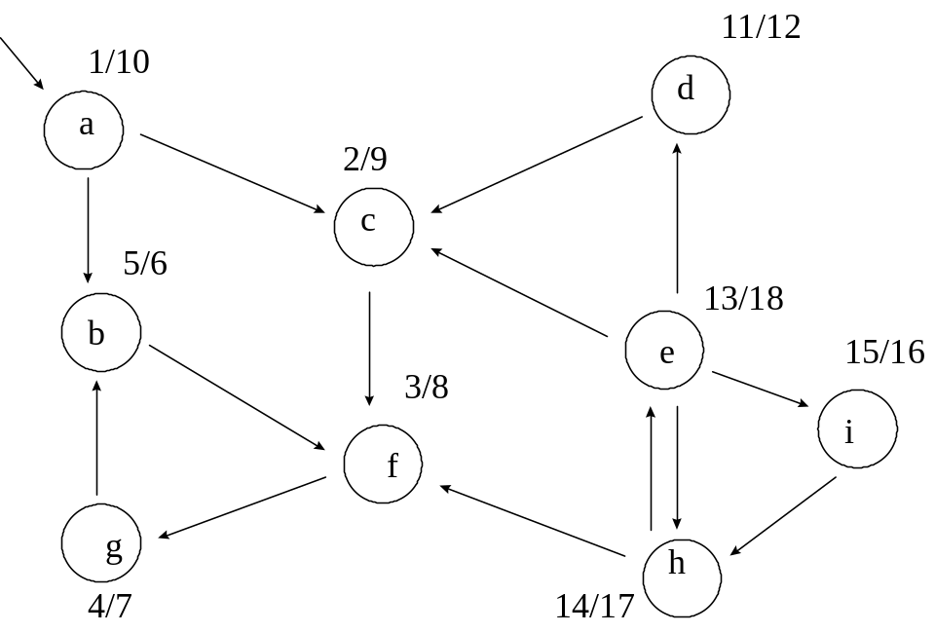
DFS Example
What if some nodes are unreachable? We still visit those nodes in DFS. Consider if c-e, f-h links were reversed. Then we end up with two separate trees
  Still visit all vertices and get a forest: a set of unconnected graphs without cycles (a tree is a connected graph without cycles).

Slide 46
Depth-First Search: Detect Edge
Data: color[V], time, prev[V],d[V], f[V]
DFS(G) // where prog starts
{
for each vertex u ∈ V
{
color[u] = WHITE;
prev[u]=NIL;
f[u]=inf; d[u]=inf;
}
time = 0;
for each vertex u ∈ V
if (color[u] == WHITE)
DFS_Visit(u);
}
DFS_Visit(u)
{
color[u] = GREY;
time = time+1;
d[u] = time;
for each v ∈ Adj[u]
{
detect edge type using “color[v]”
if(color[v] == WHITE){
prev[v]=u;
DFS_Visit(v);
}}
color[u] = BLACK;
time = time+1;
f[u] = time;
}

Slide 47
DFS: Kinds Of Edges
Thm 22.10: If G is undirected, a DFS produces only tree and back edges
Proof by contradiction:
  Assume there’s a forward edge
    But F? edge must actually be a
    back edge (why?)
source
F?

Slide 48
DFS: Kinds Of Edges
Thm 23.9: If G is undirected, a DFS produces only tree and back edges
Proof by contradiction:
  Assume there’s a cross edge
    But C? edge cannot be cross:
    must be explored from one of the
    vertices it connects, becoming a tree
    vertex, before other vertex is explored
    So in fact the picture is wrong…both
    lower tree edges cannot in fact be
    tree edges
source
C?

Slide 49
DFS And Graph Cycles
Thm: An undirected graph is acyclic iff a DFS yields no back edges
  If acyclic, no back edges (because a back edge implies a cycle
  If no back edges, acyclic
    No back edges implies only tree edges (Why?)
    Only tree edges implies we have a tree or a forest
    Which by definition is acyclic
Thus, can run DFS to find whether a graph has a cycle

Slide 50
DFS And Cycles
How would you modify the code to detect cycles?
Data: color[V], time, prev[V],d[V], f[V]
DFS(G) // where prog starts
{
for each vertex u ∈ V
{
color[u] = WHITE;
prev[u]=NIL;
f[u]=inf; d[u]=inf;
}
time = 0;
for each vertex u ∈ V
if (color[u] == WHITE)
DFS_Visit(u);
}
DFS_Visit(u)
{
color[u] = GREY;
time = time+1;
d[u] = time;
for each v ∈ Adj[u]
{
if (color[v]==WHITE){
prev[v]=u;
DFS_Visit(v);
}
}
color[u] = BLACK;
time = time+1;
f[u] = time;
}

Slide 51
DFS And Cycles
What will be the running time?
Data: color[V], time, prev[V],d[V], f[V]
DFS(G) // where prog starts
{
for each vertex u ∈ V
{
color[u] = WHITE;
prev[u]=NIL;
f[u]=inf; d[u]=inf;
}
time = 0;
for each vertex u ∈ V
if (color[u] == WHITE)
DFS_Visit(u);
}
DFS_Visit(u)
{
color[u] = GREY;
time = time+1;
d[u] = time;
for each v ∈ Adj[u]
{
if (color[v]==WHITE){
prev[v]=u;
DFS_Visit(v); }
else {cycle exists;}
}
color[u] = BLACK;
time = time+1;
f[u] = time;
}

Slide 52
DFS And Cycles
What will be the running time?
A: O(V+E)
We can actually determine if cycles exist in O(V) time
  How??

Slide 53
DFS And Cycles
What will be the running time for undirected graph to detect cycle?
A: O(V+E)
We can actually determine if cycles exist in O(V) time:
  In an undirected acyclic forest, |E| ≤ |V| - 1
  So count the edges: if ever see |V| distinct edges, must have seen a back edge along the way

Slide 54
DFS And Cycles
What will be the running time for directed graph to detect cycle?
A: O(V+E)

Slide 55
Reference
Cormen –
  Chapter 22 (Elementary Graph Algorithms)
Exercise –
  22.3-4 –Detect edge using d[u], d[v], f[u], f[v]
  22.3-11 – Connected Component
  22.3-12 – Singly connected

